Slide 1
Modified Augmented Reality Based Navigation system for the Blind
By
Tehemton khairabadi 1313023
Deepika palukurthi 1313055
Pooja shivhare 1313054

Slide 2
Introduction
About 285 million people are visually impaired worldwide. The world's visually impaired people primarily live in developing countries.
Our project is primarily aimed at the legally blind people which consist of a large fraction of our population.
Stereo vision is an area within the field of computer vision that addresses an important research problem: which is the reconstruction of the three-dimensional coordinates of points for depth estimation.

Slide 3
Stereo Vision
A system of stereo vision consists of a stereo camera, namely, two cameras placed horizontally (i.e., one on the left and the other on the right).
The two images captured simultaneously by these cameras are then processed for the recovery of visual depth information.

Slide 4
Stereo Vision contd
Each eye captures its own view and the two separate images are sent on to the brain for processing.
The mind combines the two images by matching up the similarities and adding in the small differences.
The small differences between the two images add up to a big difference in the final picture.
The combined image is more than the sum of its parts. It is a three-dimensional stereo picture.

Slide 5
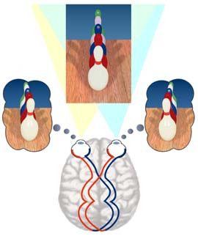
Stereo vision contd

Slide 6
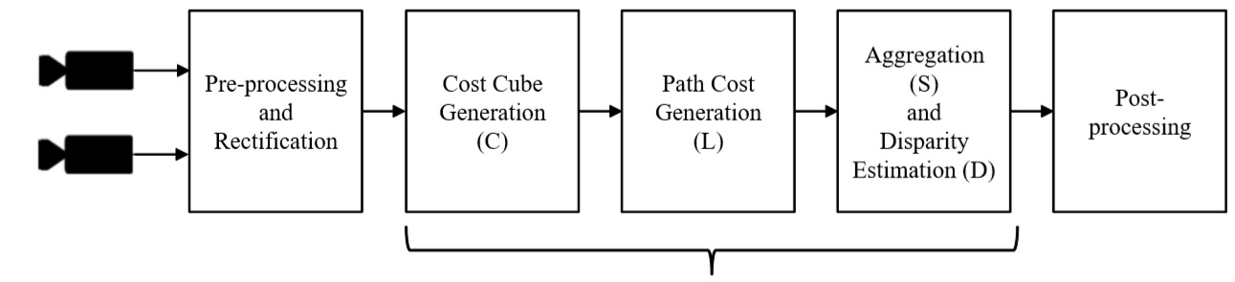
SGBM algorithm Semi Global Block Matching

Slide 7
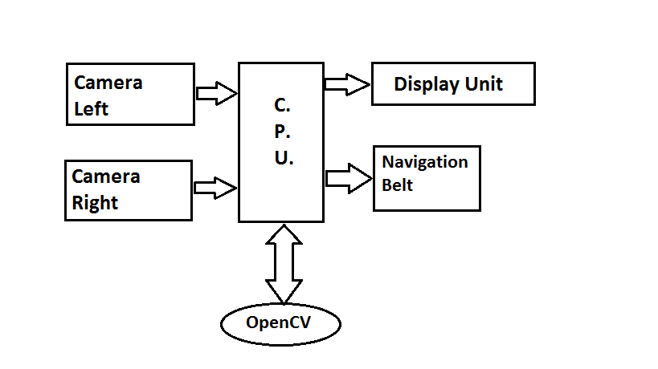
Implementation

Slide 8
Implementation contd.
We have two cameras, one for capturing the image from the left direction and one for capturing the image from the right direction.
Combining these two 2D images, we will generate a 3D image for the depth map.
These images are captured and then sent to the C.P.U for further processing.

Slide 9


Test images

Slide 10
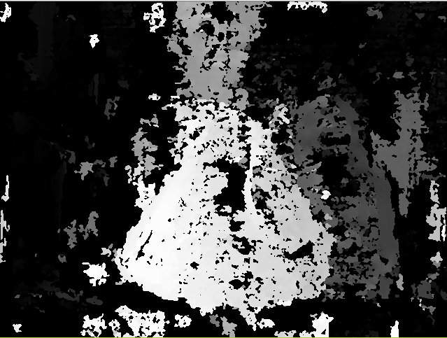
Result

Slide 11
Navigation belt
The navigation belt is the second half of the navigation system
It is used to help the visually impaired to re-orient themselves in the right direction

Slide 12
What does it require?
It utilizes the following components:
Arduino Uno Microcontroller
8 vibration motors
Triple-axis Magnetometer
I2C controller

Slide 13
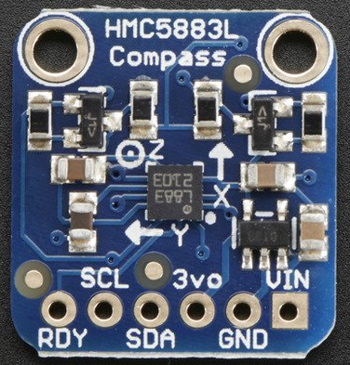
Triple-axis magnetometer
For the navigation belt, we use the HMC5883L.

Slide 14
Triple-axis magnetometer
A magnetometer can sense where the strongest magnetic force is coming from, generally used to detect magnetic north.
It uses I2C to communicate

Slide 15
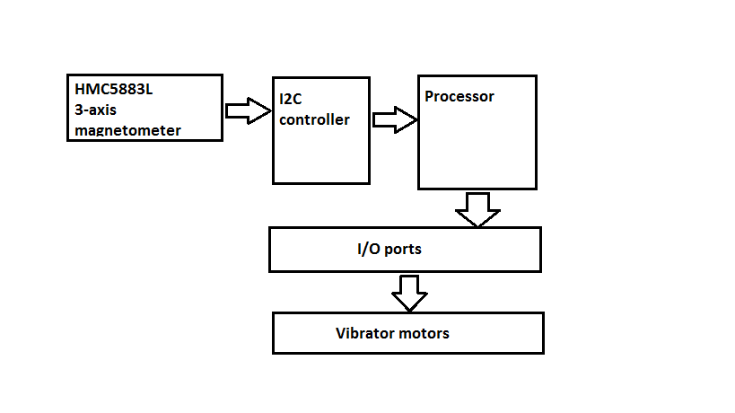
How does it work?
Block diagram

Slide 16
Working
Magnetometer readings are taken to find North
Specific vibrator motor pointing in the north direction is made to vibrate
As direction of North changes, so does the vibrator meter which gets the signal to vibrate
Hence, letting the blind person get a sense of orientation

Slide 17
THANK YOU

